Slide 1
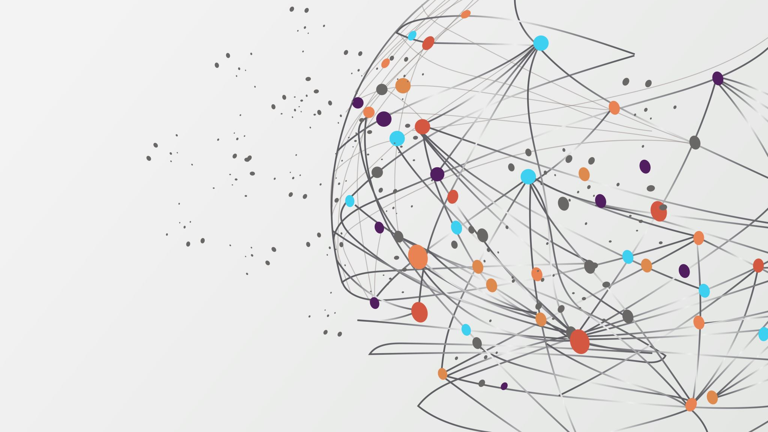
Movie Recommendation with Neural Networks
Josh Graham

Slide 2




About Me
Aspiring Data Scientist
Naval Architecture and Engineering Background
Live on Vancouver Island
Love Movies
Interested in Neural Networks
Notes:
For my final project I wanted to create a recommender system. I love movies and I was always very curious how the streaming services created their recommender systems. I also wanted to take the final project as an opportunity to better understand neural networks.

Slide 3
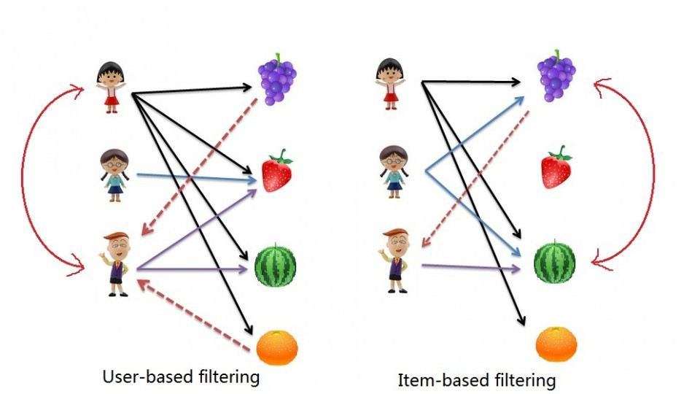
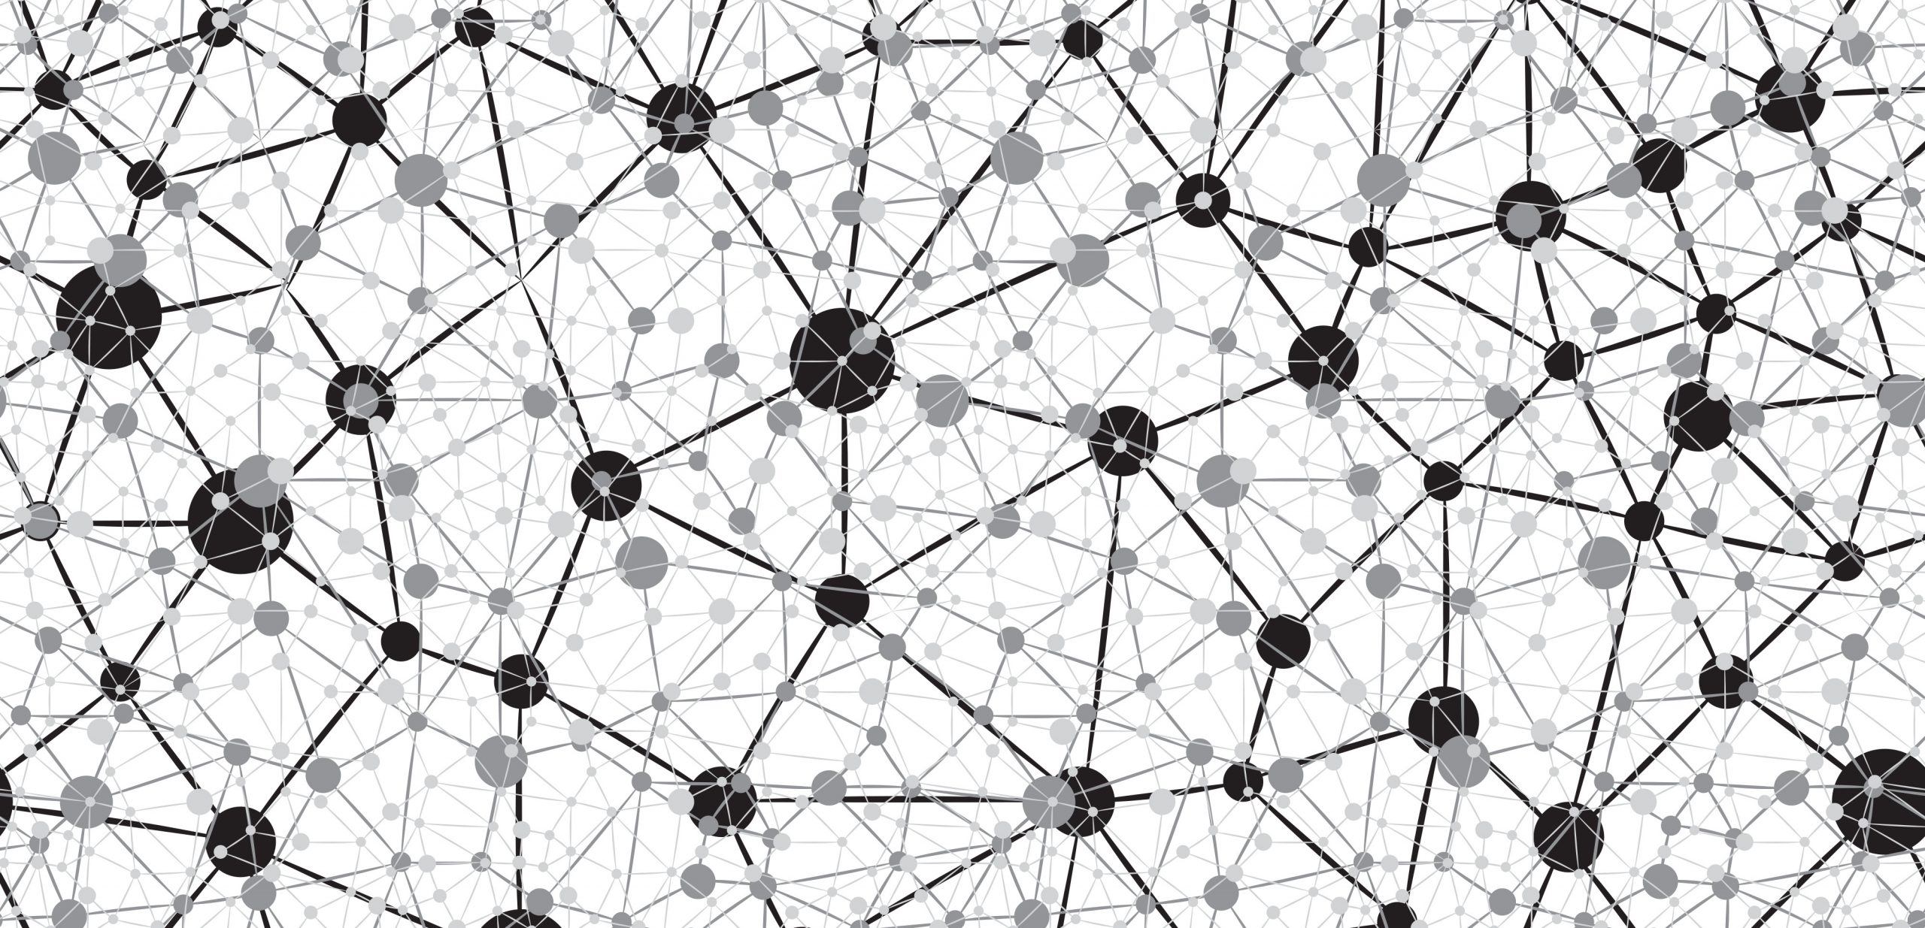
Recommendation Systems
Content Based Filtering
Collaborative Filtering
Neural Networks
Notes:
We all know how overwhelming it can be to try find something to watch when scrolling through streaming services. There are too many options!
That's where recommendation systems come in, helping us discover new films that align with our interests.
The two main recommendation techniques we learned about during the bootcamp were:
Content-based filtering, which suggests movies similar to those a user has shown interest in.
And collaborative filtering, which leverages the preferences of similar users to make movie recommendations.
Despite the usefulness of these techniques, these methods have limitations in capturing complex user preferences and patterns.
That's where neural networks come into the picture.

Slide 4
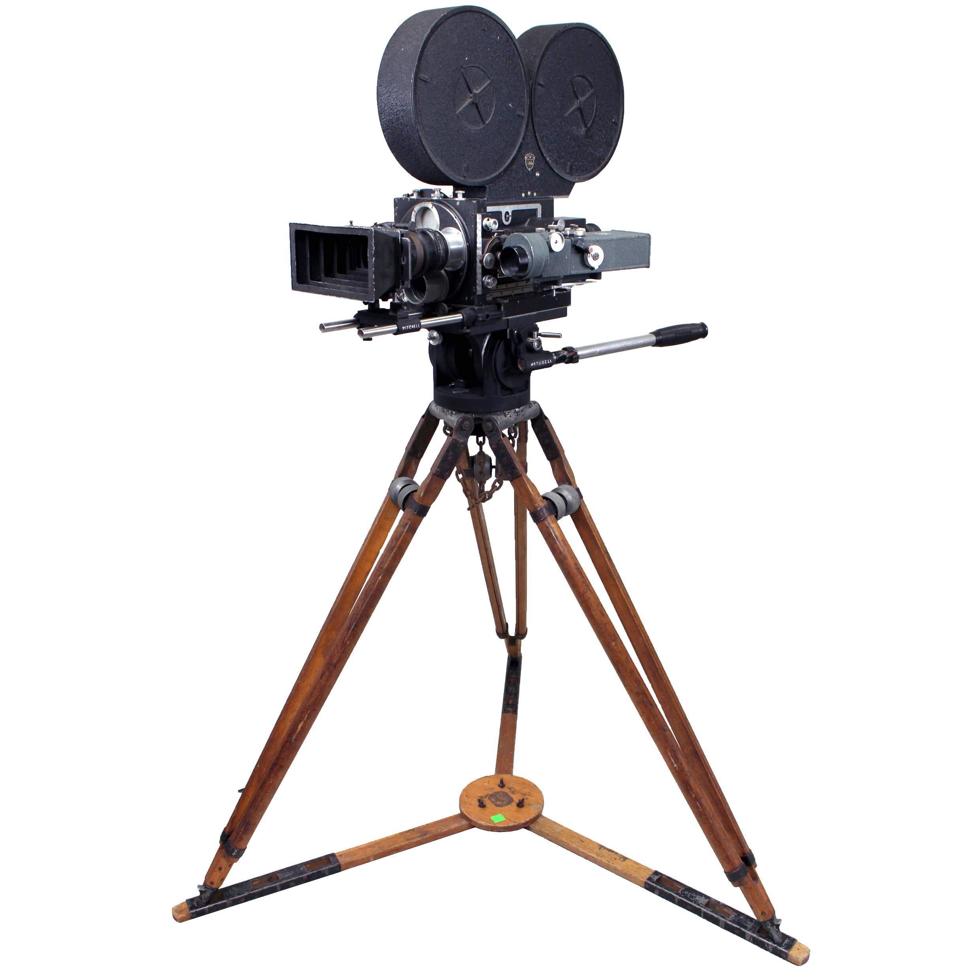
MovieLens Data Set
Comprehensive Movie Information
(58,000 movies and 27 million ratings)
Movie Data
User Rating Data
Tag Data
Notes:
At the heart of my movie recommender system lies the MovieLens dataset.
This dataset contains user ratings for various movies, along with additional movie information, such as genres and tags.
The dataset has 58,000 movies and 27 million ratings. The data was created from 283,000 user ratings between 1995 and 2018.

Slide 5
Recommender Model
User – Movie Ratings
Recommender
Model
Movie Genres
User – Movie Ratings
Movie Tags
Notes:
Here we have a simple flow chart showing how the recommender model works. The model takes user-moving ratings, movie genres and movie tags as inputs to the model.
The ouput of the model is predicted ratings by a user.

Slide 6
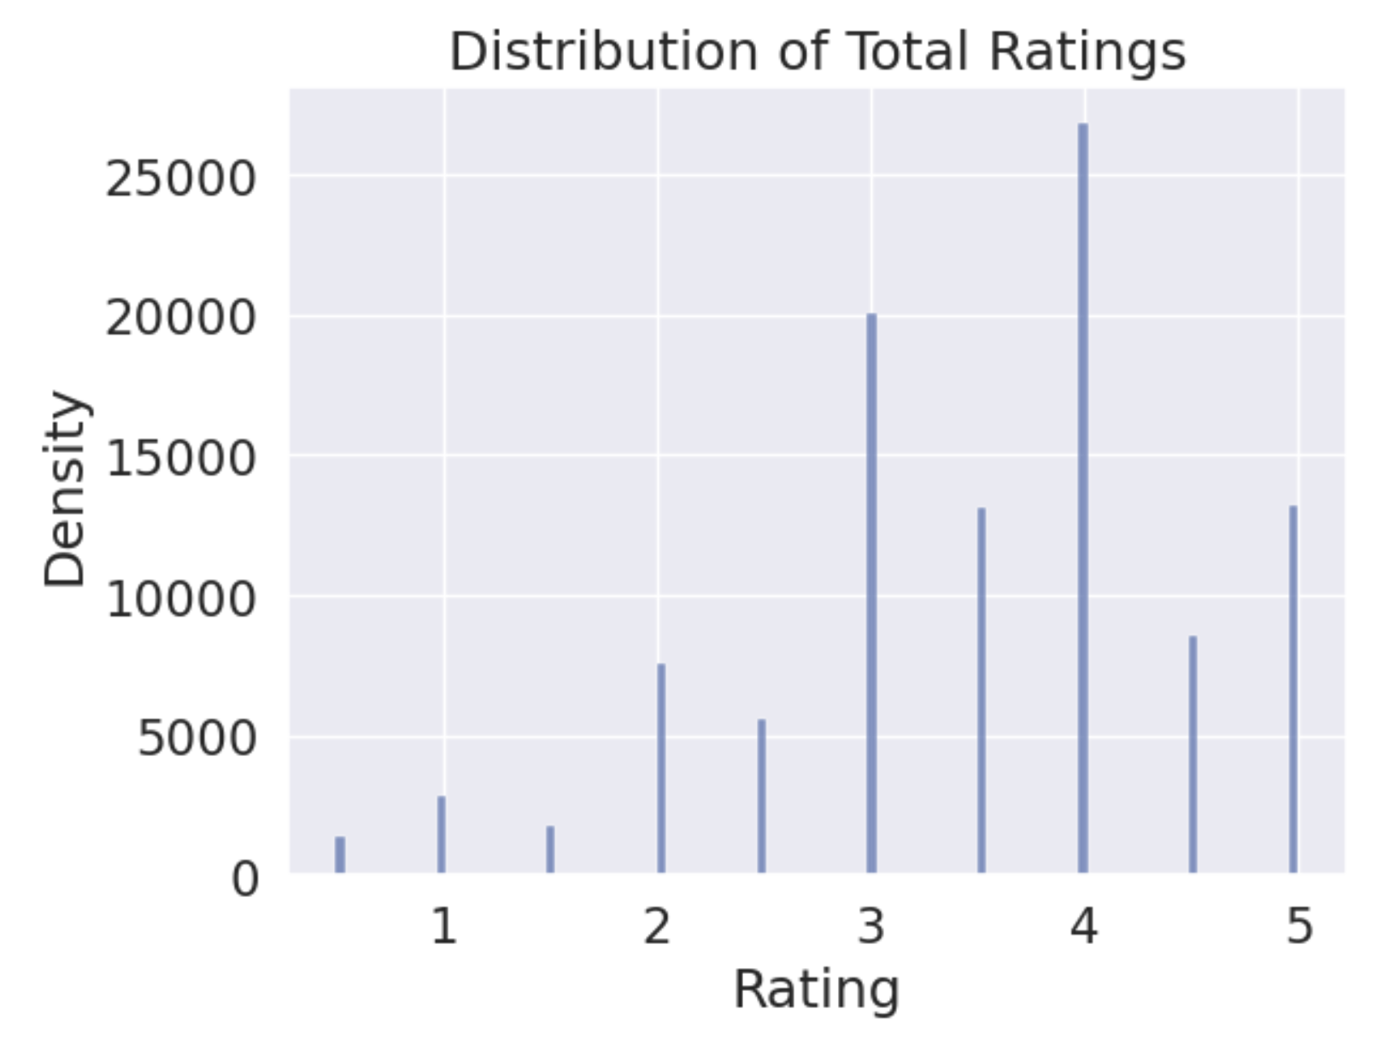
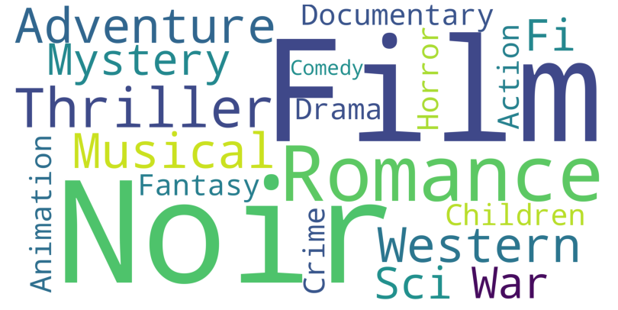
Data Analysis and Preprocessing
Ratings Data
Normalize Ratings
Recommender Model
Genre Data
One Hot Encode Genres
Recommender Model
Notes:
Before training my model, I performed exploratory data analysis (EDA) to gain insights into the dataset. EDA helped us identify data patterns, outliers, and potential issues that could impact our recommendations.
First, I went through the user movie ratings. On the right we can see the distribution of total ratings. The ratings are skewed to be more favorable, with the most frequent rating to be 4/5.
Before being fed to the model ratings were normalized between 0 and 1 to improve the numerical stability of the computations in the neural network.
Next, I went through the genre data. The data had 20 genres across all of the moves in the data set, with some movies having multiple genres. A word cloud of the genres can be seen on the right. The genres of the films were one hot encoded and a genre matrix was prepared for input to the model.

Slide 7
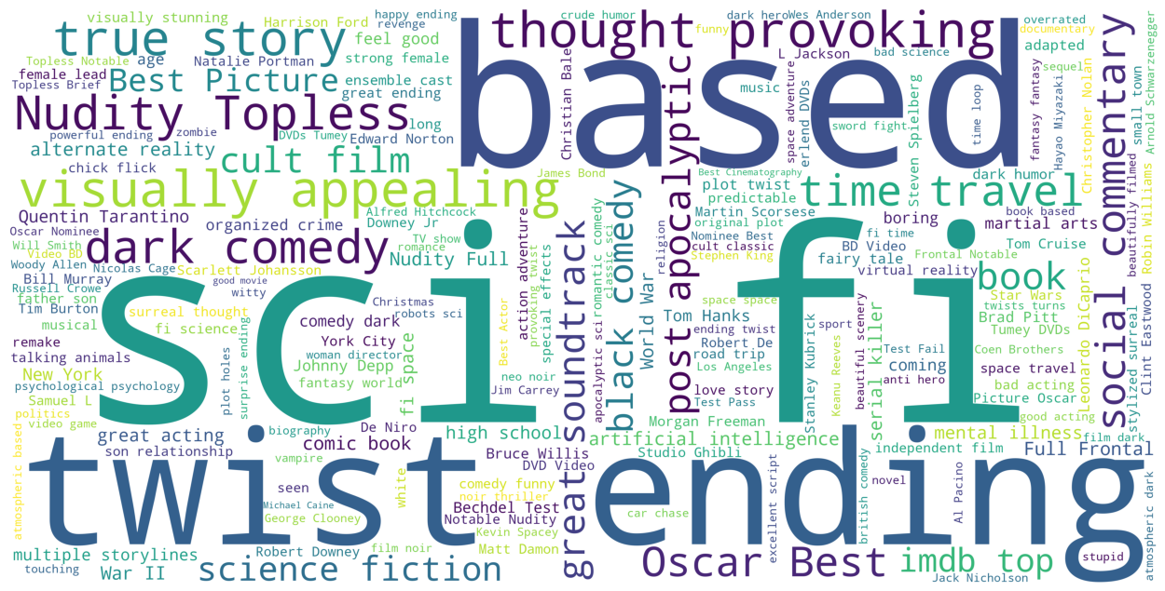
Data Analysis and Preprocessing
Tag Data
Filter Tags by Frequency
Recommender Model
Aggregate Tags by Film
One Hot Encode Tags
Remove Duplicate Tags
Notes:
Finally, I did data exploration and preprocessing of the movie tags. A word cloud of all the tags in the data set can be seen below.
Tags needed to be filtered by how often they occurred. A lot of tags in the data set were very obscure and only occurred once. If a tag occurred less than 200 times it was removed. Tags were then aggregated by film and duplicates were removed. Tags were one hot encoded and a tag matrix was prepared as input to the model.

Slide 8
Recommender Model Architecture
User – Movie Embeddings
Genre Features
Tag Features
Collaborative Filtering
Fully Connected Neural Network
Fully Connected Neural Network
Fully Connected Neural Network
Merge
Notes:
Here we can see what's under the hood on the recommender system, where the system combines collaborative filtering with the power of neural networks.
Collaborative filtering focuses on the user-movie interactions, learning from the preferences of similar users to make recommendations.
The neural network components of the system consists of multiple layers that process user and movie embeddings, as well as genre and tag features.
These layers are designed to learn complex relationships and interactions among these elements. With activation functions and dense layers, our neural network learns non-linear patterns resulting in more accurate predictions.

Slide 9
Model Training and Evaluation
With the data prepared and the model architecture defined, the model was trained on the preprocessed Movielens data.
Model parameters were optimized to minimize prediction errors and make better recommendations.
Root mean squared error was used to evaluate the model's performance.
The results demonstrated the system's accuracy and effectiveness in making movie recommendations tailored to individual users.
Notes:
With the data prepared and the model architecture defined, I proceeded to train the model on the MovieLens dataset.
During training, I optimized the model parameters to minimize prediction errors and make better recommendations.
Root mean squared error was used to evaluate the model's performance.
The results of the evaluation demonstrated the system's accuracy and effectiveness in making movie recommendations tailored to individual users.

Slide 10


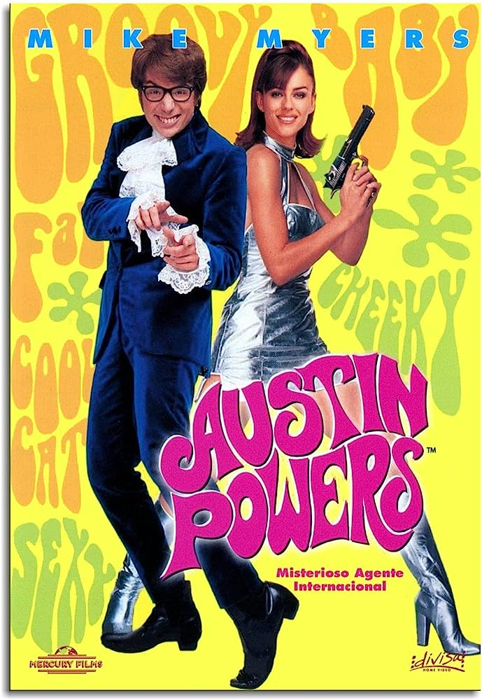


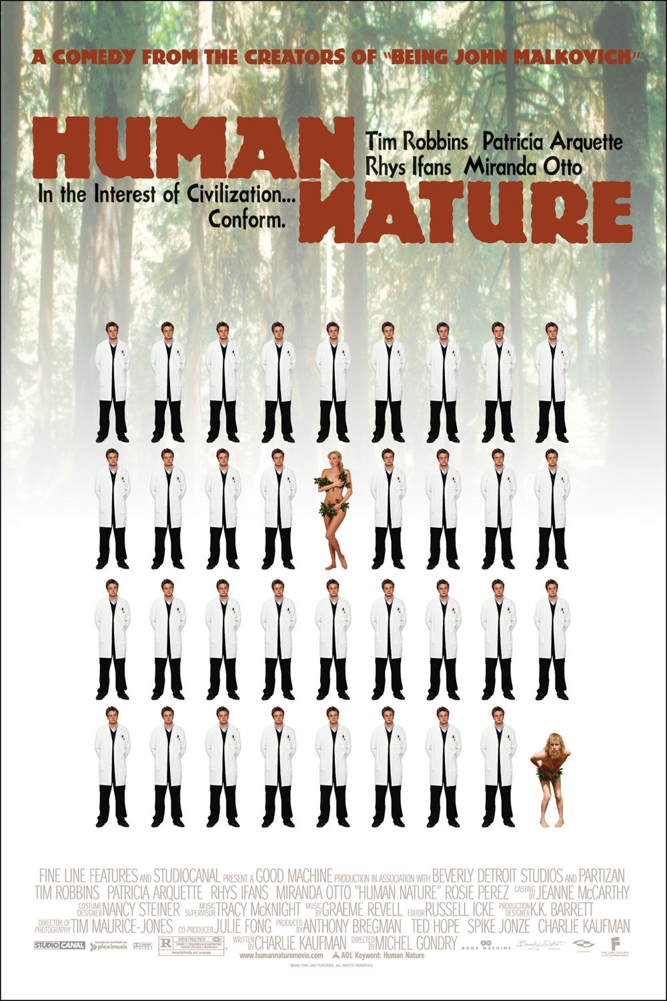




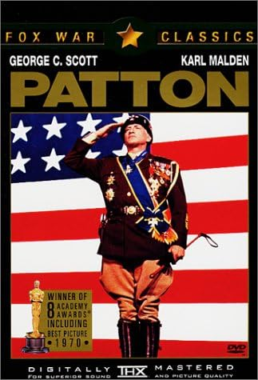

Results
Favorite Movies
Top 3 Recommendations
User 1
User 8

Slide 11
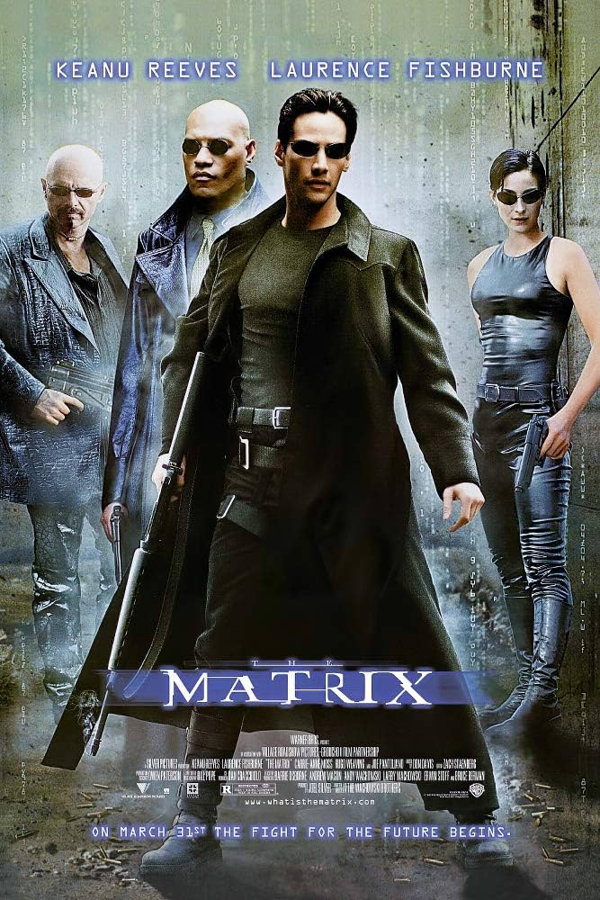
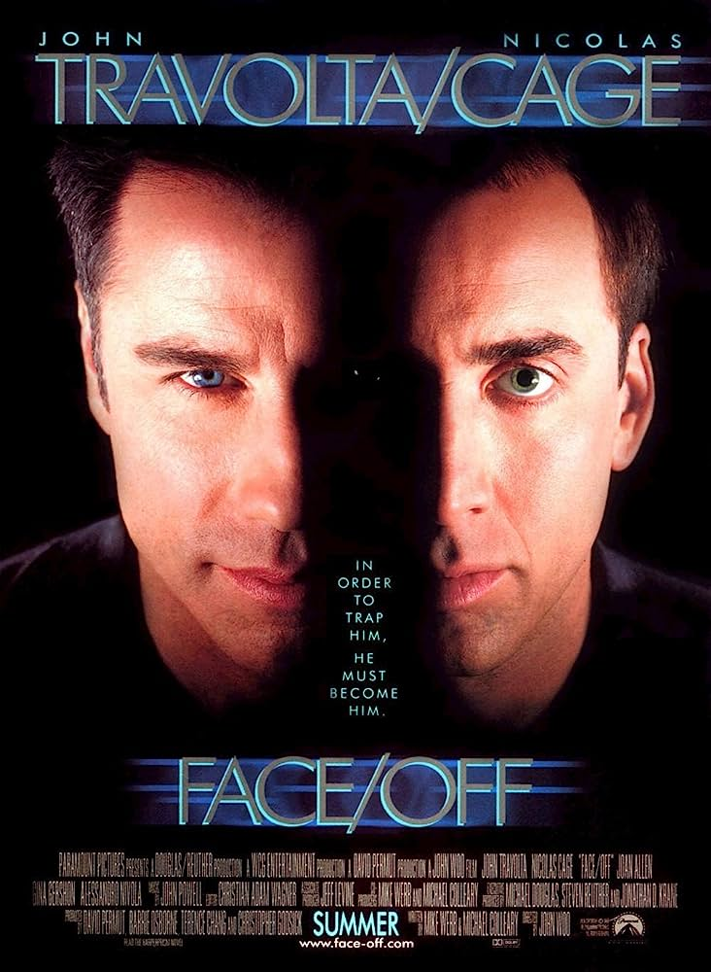
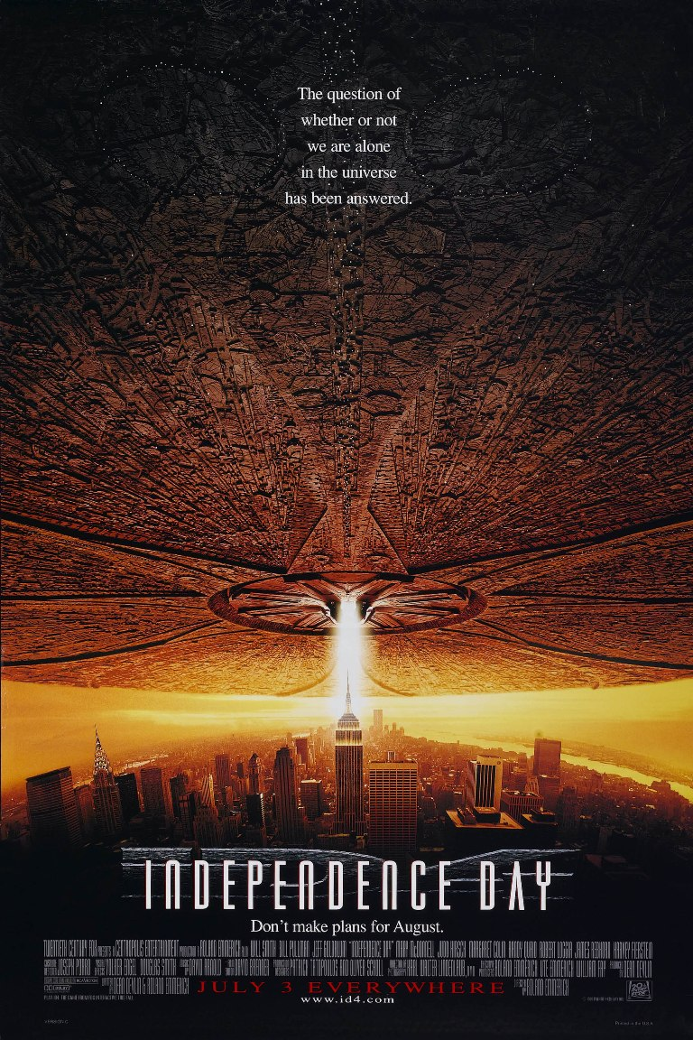





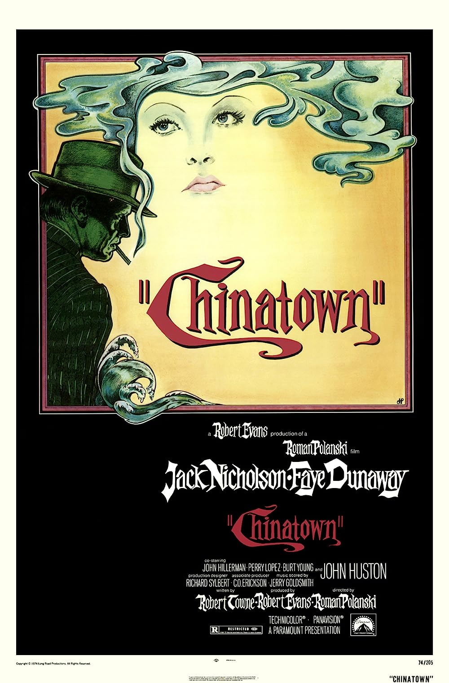
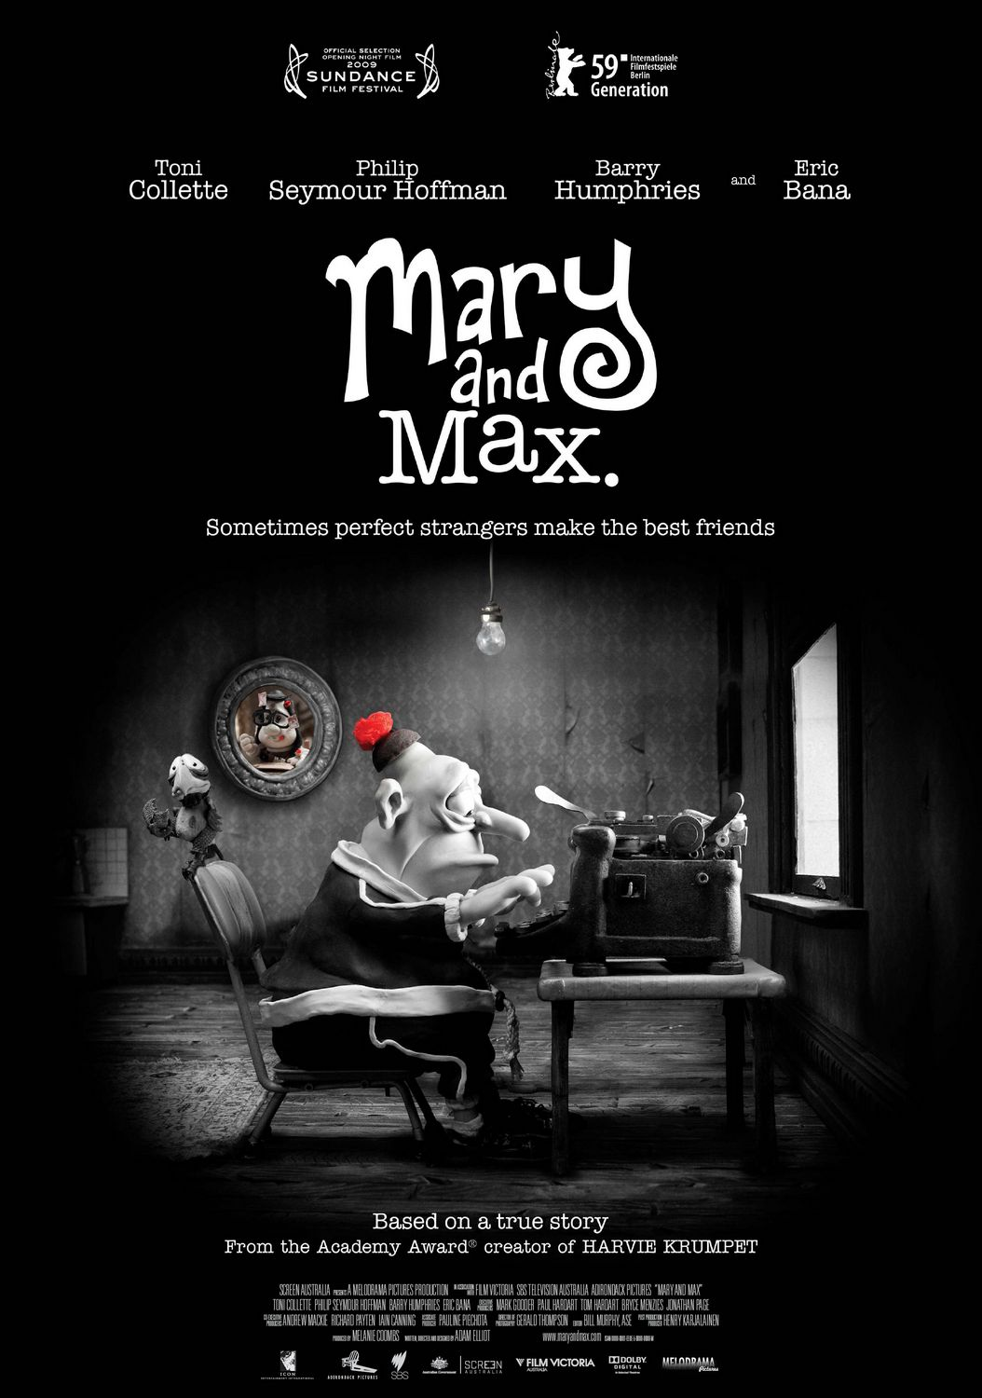

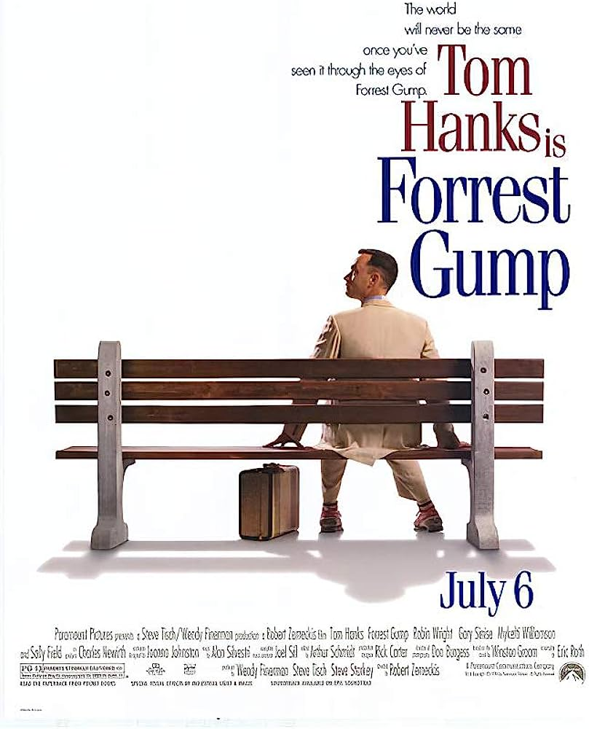
Results
Favorite Movies
Top 3 Recommendations
User 579
User 444

Slide 12
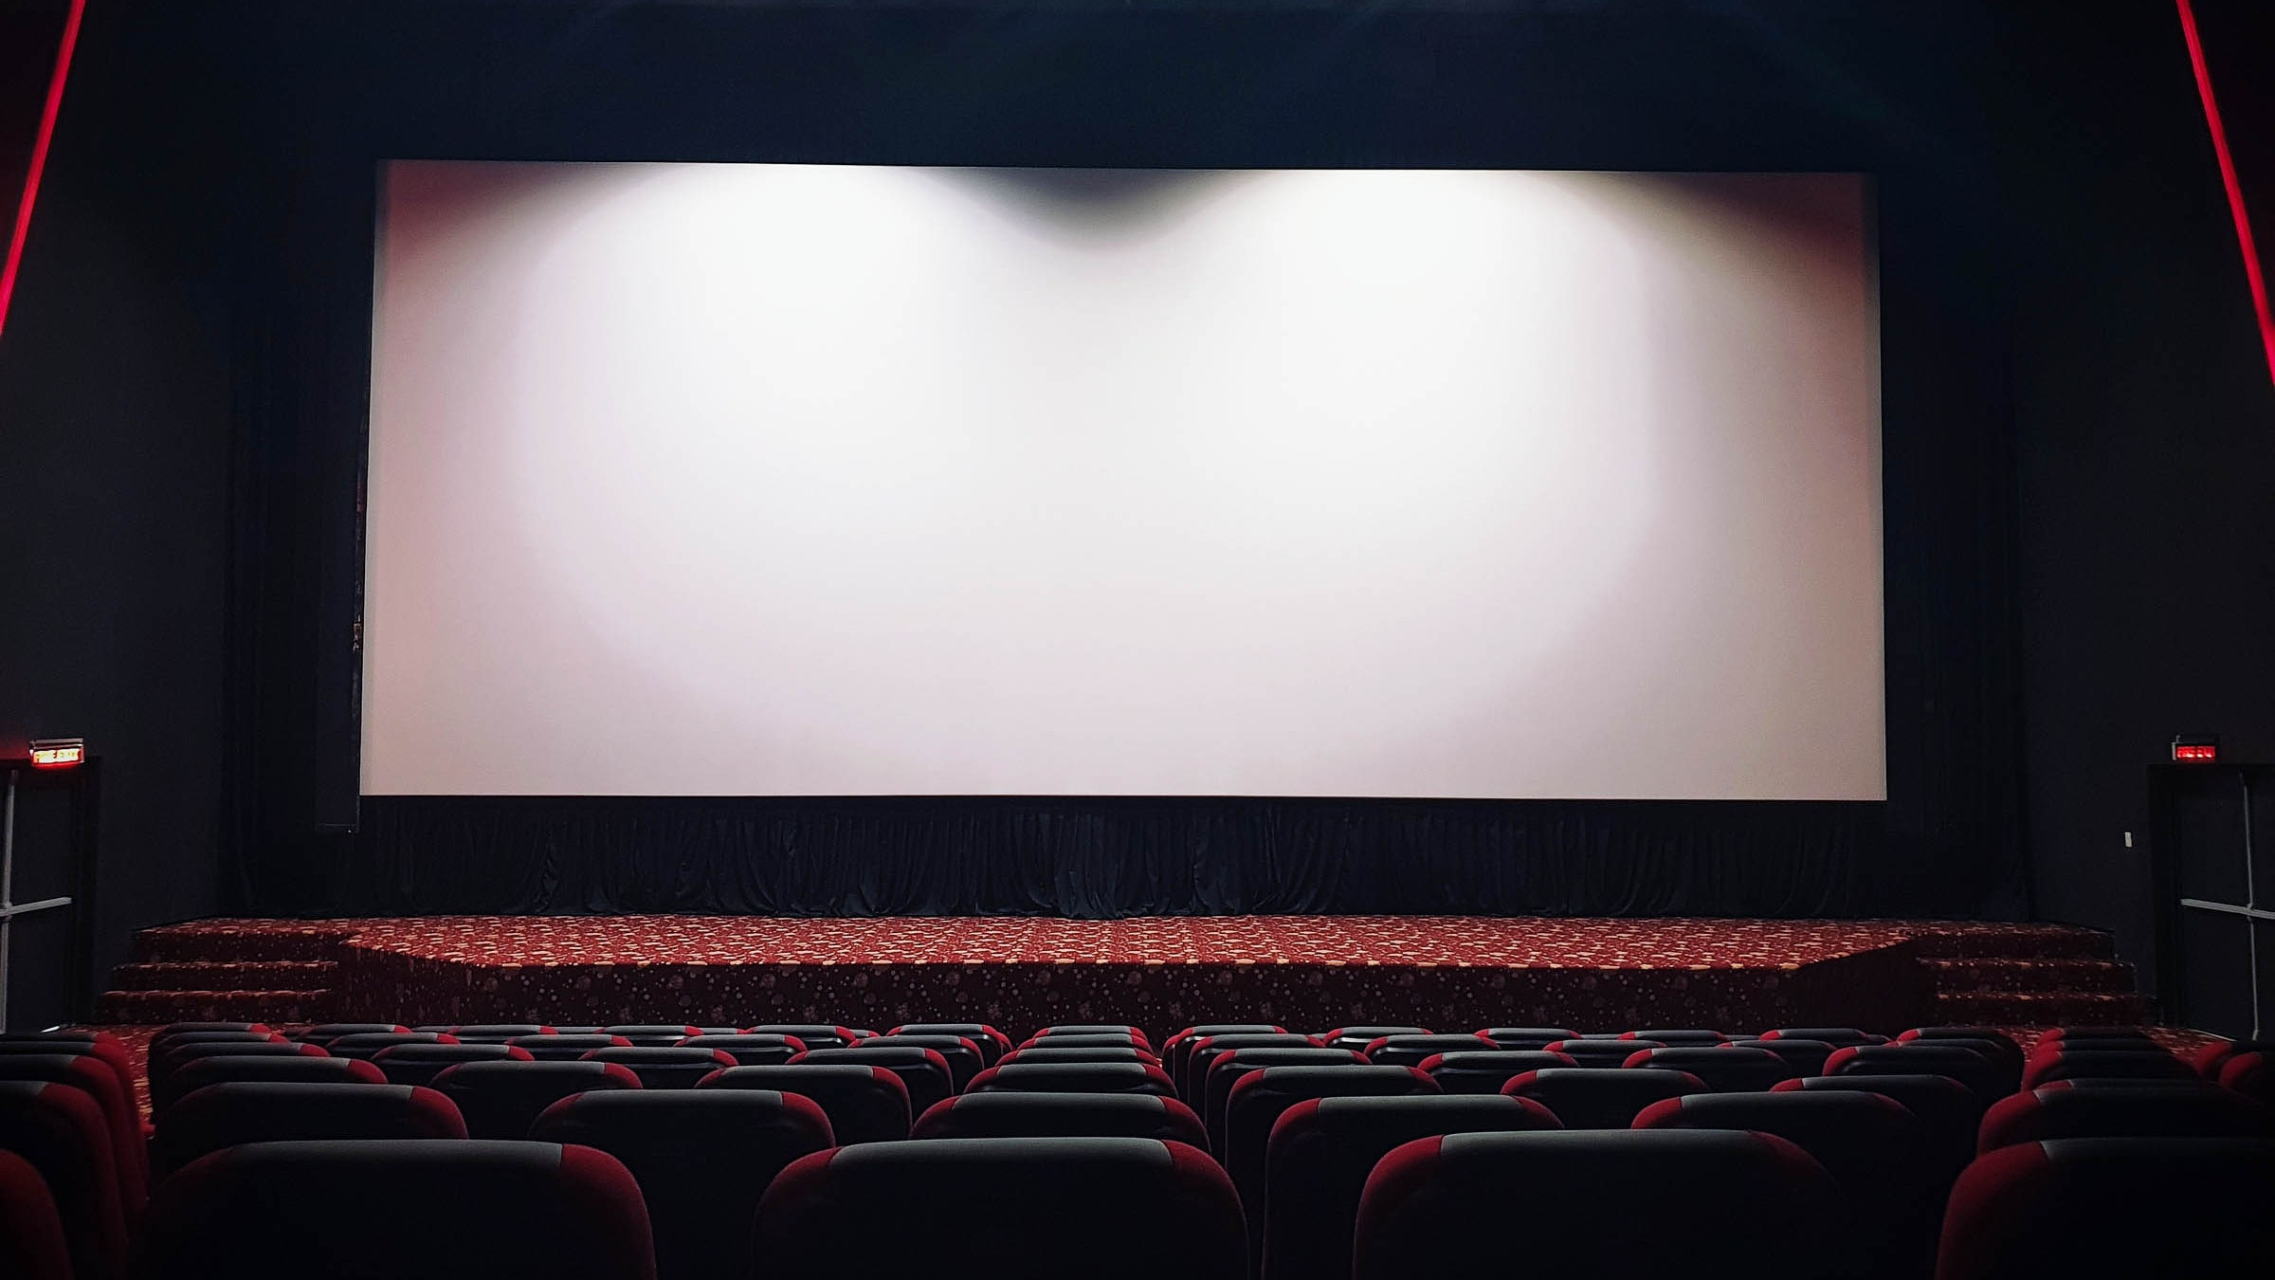
Thanks!

